Slide 1
QSN Consumer rights and Gen Z
Prof Becky Huxley-Binns
Vice-Provost
The University of Law

Slide 2
The law
Business – consumer
Trader providing a service
Terms – clear, intelligible, unambiguous, timely

Slide 3
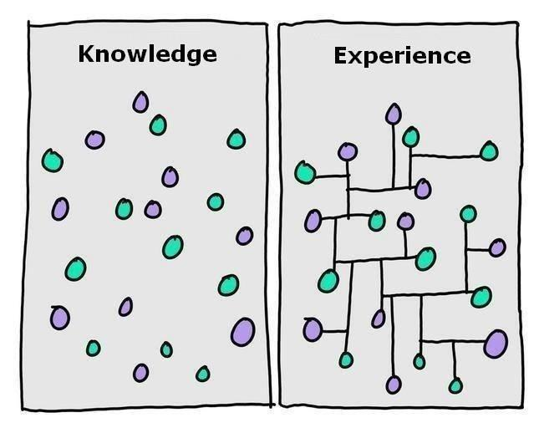
Effects?

Slide 4
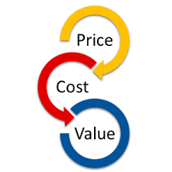
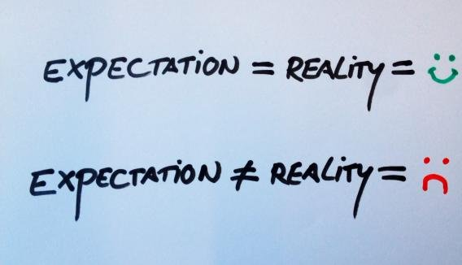
What’s to be done?

Slide 5
Student expectations – from a generation of paradoxes

Slide 6
Student behaviours – from a generation of paradoxes

Slide 7
