Slide 1
Developing data skills for the Quality Practitioner
Paula Keys, Head of Planning & Performance
Chris Laity, Associate Registrar
University of South Wales
(slides redacted in some areas)

Slide 2
Content
Why?
What and How?
Challenges
Approaches (tried and tested)
Examples
Discussion

Slide 3
Why?
The increasing use of metrics, data, measures in HE

Slide 4
Student Experience
‘In Higher Education students are leaving a data footprint behind in the course of their study which tells us about their learning and experiences at University. Universities can use this data to understand how students learn and optimize the student experience’ Analytics and Higher Education
Effectiveness
Organisations require access to accurate, timely and meaningful information about their core businesses and the environment in which they operate, if they are to adapt and thrive during times of great uncertainty – JISC
Marketing
Universities must analyze and monitor enrollment trends, geographic, demographic and diversity data, and student satisfaction and retention rates to appeal to the right mix of students – Business Wire
© University of South Wales

Slide 5
Metrics in the Sector – Collected Data
How many definitions of data do HESA have?
Student
Destinations of Leavers
Staff
Finances
HE Business and Community Interactions
Estates
Grand Total
58
35
36
16
15
216
376

Slide 6
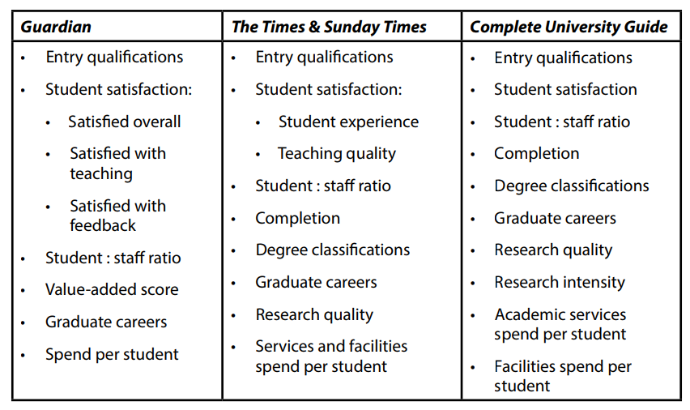
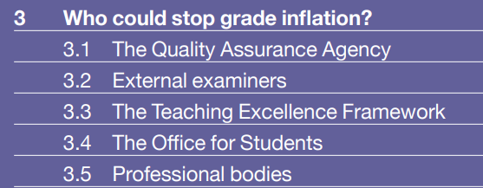
Metrics in the Sector – League Tables
Dangers
“All in all, league tables are in many ways comparing apples with pears and oranges, and this does not allow the rich diversity of the UK higher education sector to be appreciated.”
Source: A Guide to UK League Tables in Higher Education

Slide 7
Metrics in the Sector
How does TEF work with current quality assurance work?
TEF is supposed to differentiate institutions above a baseline standard determined by pre-existing quality assurance systems.
WonkHE
Quality Assurance ++??

Slide 8
Other Drivers – Value for Money?
The Telegraph
The Guardian

Slide 9
Other Drivers – Value for Money?
https://www.gocompare.com/savings/degree-of-value/#table

Slide 10
Other Drivers – Value for Money?
How do we promote value for money?
Limits on tuition fees
Offering quality assurance
Promoting excellent teaching
Providing the right information
Ensuring good governance
Protecting students’ interests
Checking providers’ finances
Making sure there are contingency plans

Slide 11
Other Drivers – Funding and Quality?
Blurring of planning and QA?
Increasingly the measure of academic provision will be an aggregate judgement based on quality, performance and financial viability – these conversations are joining up

Slide 12
What?
How?

Slide 13
Focus - Linked to Strategy and Vision
© University of South Wales

Slide 14
And…
we need to understand our own performance in the context of the wider UK sector

Slide 15
The importance of benchmarks
There are some well-established differences in scores between different subject areas. These can create exaggerated distinctions between providers, purely because of the different mix of subjects in their portfolios. Some subjects have significantly higher mean scores than others and the range of scores also tends to vary.
For example:
• the median student : staff ratio in 2016 was 7.8 for Dentistry, but 17.2 for History;
• similarly, median scores for entry tariff (the grades of A-Level or equivalent qualifications required for entry to a course) were 493 for Dentistry and 314.5 for History.
Source: A Guide to UK League Tables in Higher Education

Slide 16
The Importance of Benchmarking – the NSS
NSS | USW | Sector
Accounting | 92.48% | 86.67%
Cinematics & Photography | 81.29% | 77.25%
History | 85.29% | 89.1%
USW @Sector
History
Accounting
Photography
© University of South Wales

Slide 17
The Importance of Benchmarking – Our Institutional Population
© University of South Wales

Slide 18
The Challenges and Solutions
Data Quality
The Data Group
Increased visibility
Accessibility
Champions, at all levels
Move to visual, accessible business intelligence
Engagement and Resistance
Pick your quick wins
Create internal and external competition

Slide 19
Examples..
What works….

Slide 20
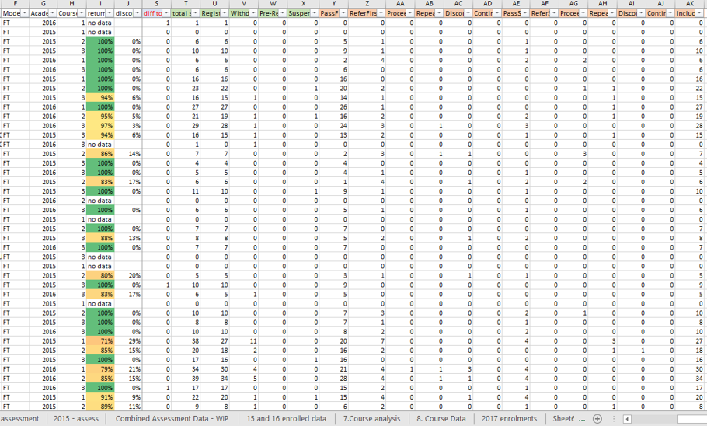
Accessibility
An Example………….
‘How did our FTUG students do in their assessments?
Course by course, line by line
© University of South Wales

Slide 21
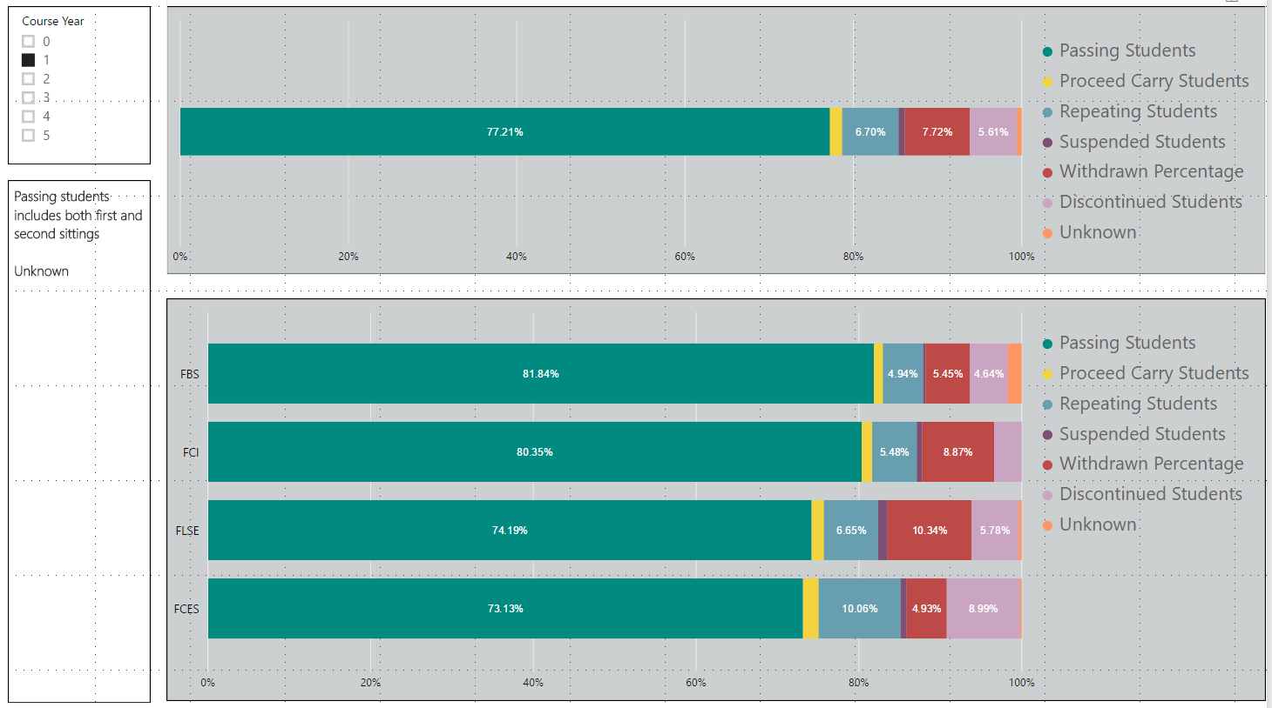
An Example………….
‘How did our FTUG students do in their assessments?
Ability to drill through structure to course level.
© University of South Wales

Slide 22
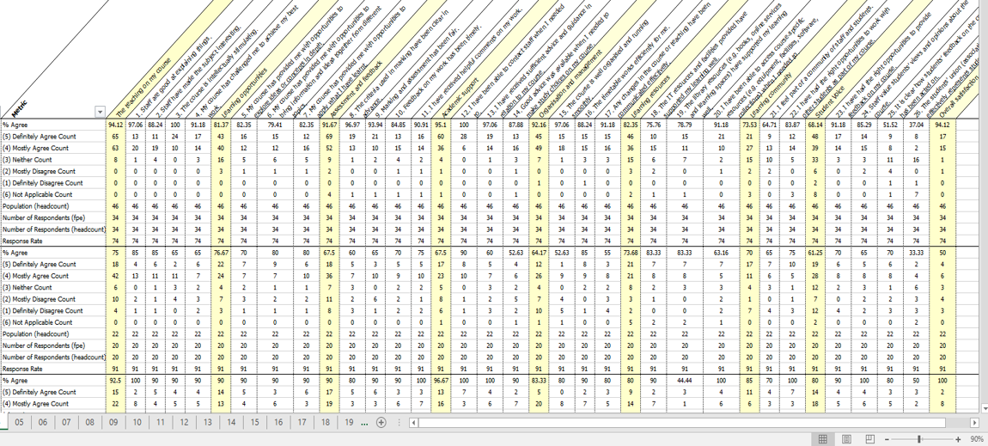
An Example………….
‘How did my course do in the NSS?
Tabs and more tabs
© University of South Wales

Slide 23
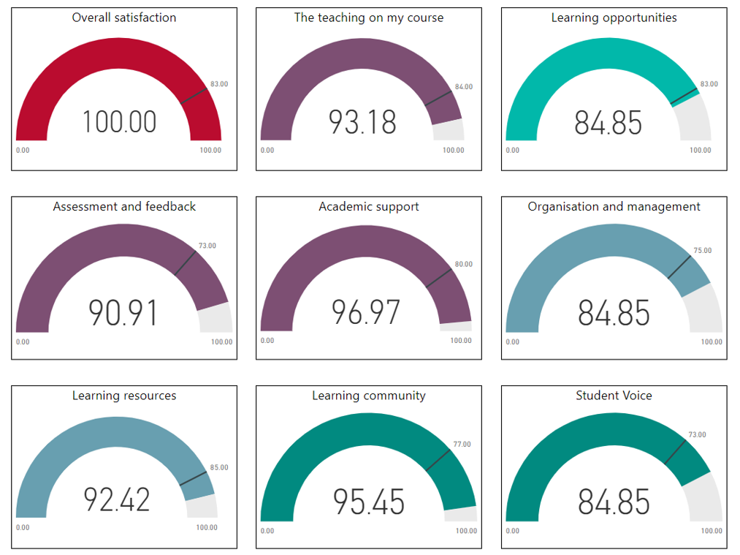
An Example………….
‘How did my course do in the NSS?
© University of South Wales

Slide 24
They like it…
I’d like to mention it’s so wonderfully beneficial to have the visibility that BI gives us. The impact is instant - certainly, if you have a competitive nature like me! It is an excellent conversation starter. Much easier than trawling through spreadsheets. We still need that detail eventually, but BI give us the visual.
As an engineer I always preach to my students about basing their decisions on fact and not fantasy, and that to move forward and continuously improve, we need visibility of accurate data that we can act upon – and focus our effort efficiently in the places that need it now.
From what I have seen thus far, BI is a great tool for us to use to enable us to start these conversations in the Faculties/Schools and subject areas.
© University of South Wales

Slide 25
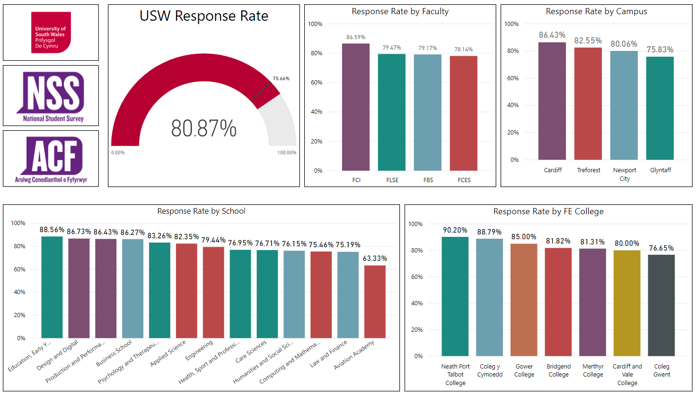
Engagement (Competition) - NSS 2018

Slide 26
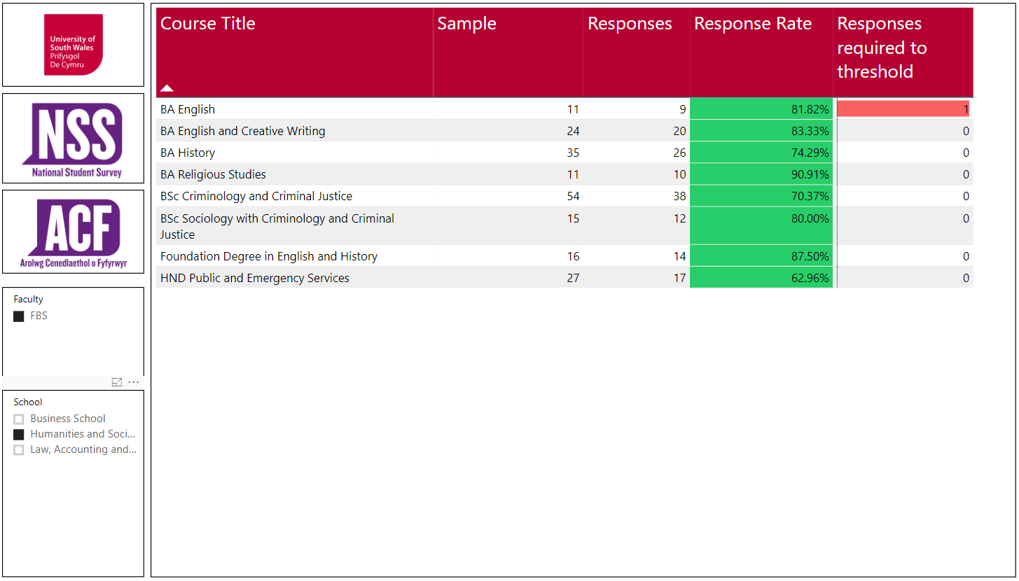

Slide 27
Impact
Increased response rate from 75 to 80%
Reduced queries
Reduced chasing of courses to hit publication threshold
Increased visibility & ownership
Instilled a sense of competition
A four percent increase in our Overall Satisfaction score…….(we did other things too)

Slide 28
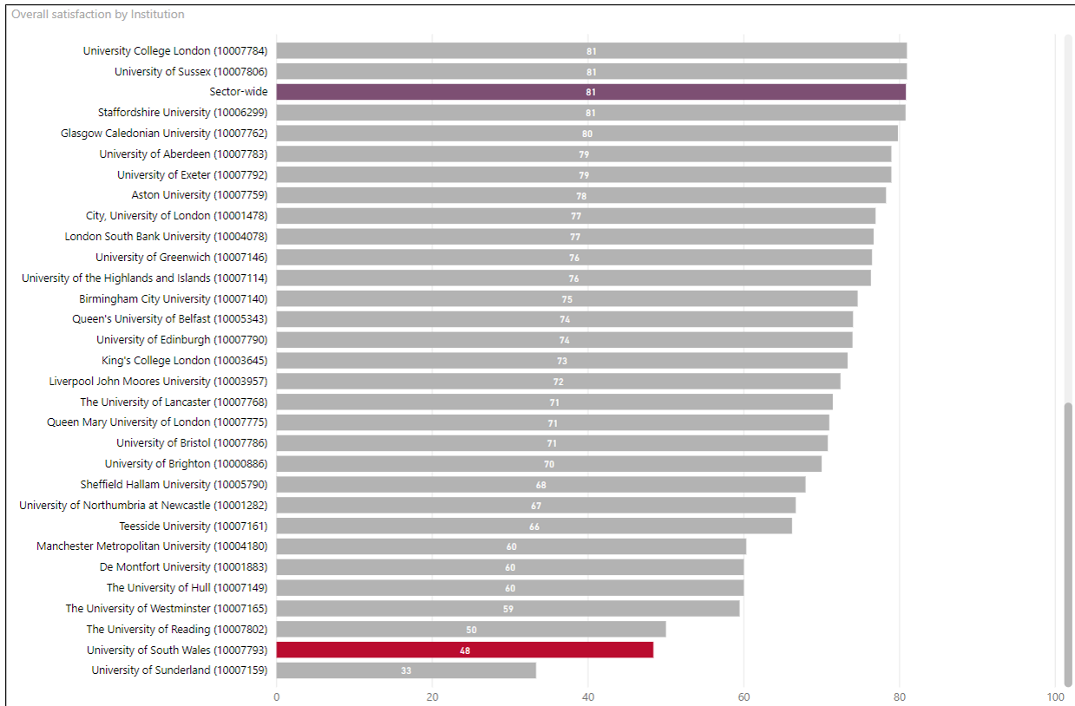
Engagement (Competition) - NSS 2018
(How far do I have to scroll down before I see USW?????)
Example one, a poorly performing subject area

Slide 29
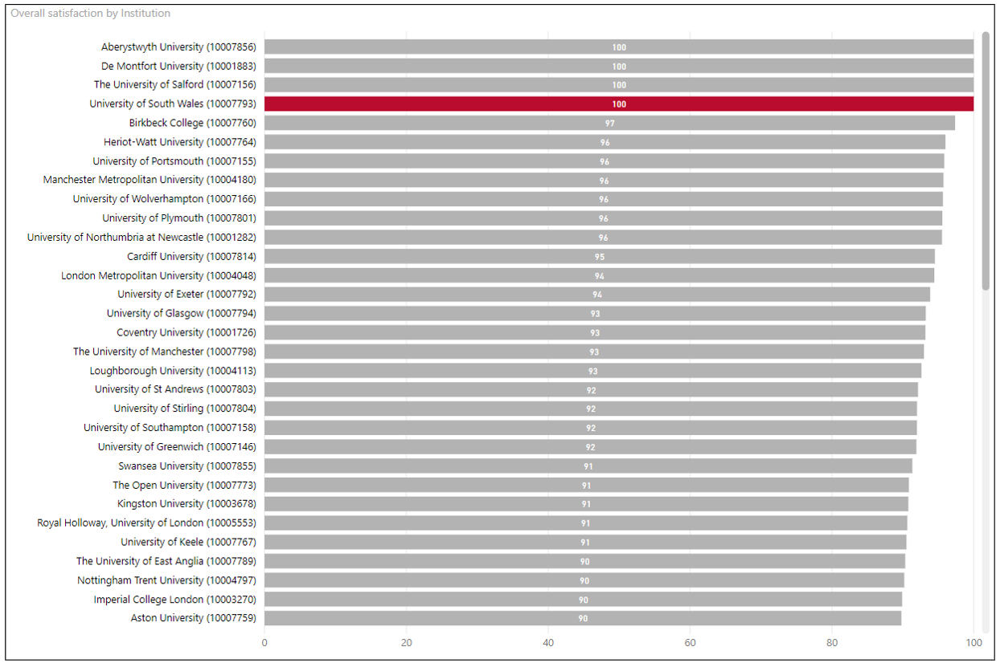
Engagement (Competition) - NSS 2018
(How far do I have to scroll down before I see USW?????)
Example two – an excellently performing subject area

Slide 30
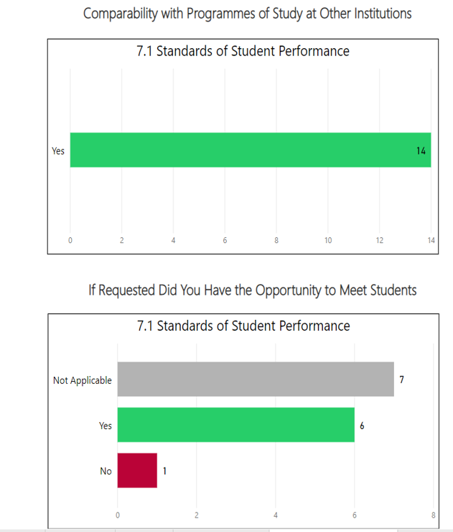
Increasing use for Operational Reporting in QA
External Examiner Reports
Provided institutional picture from micro level information
Was used to lead discussion at the University’s Quality Assurance Committee

Slide 31
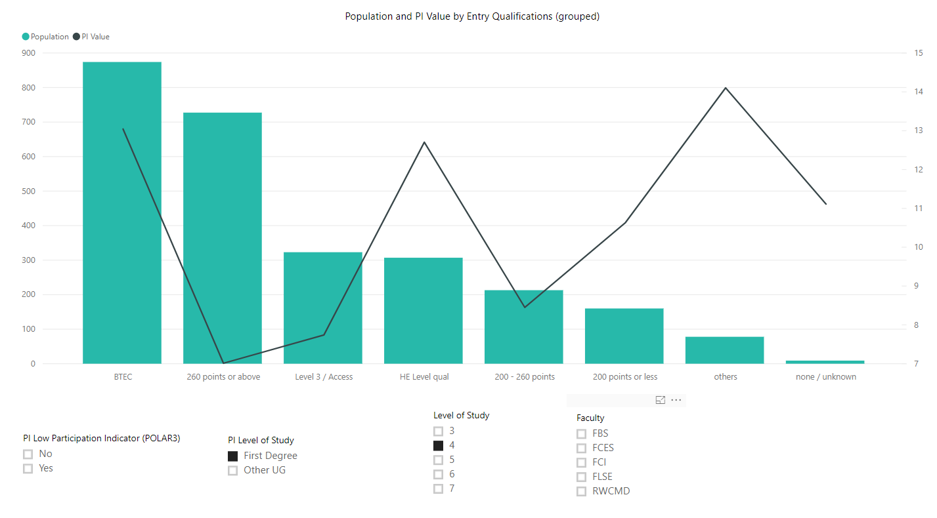
Influencing Pedagogy
Highlighted patterns in relation to the retention risk of students entering USW with BTEC qualifications. Also highlighted differences in populations linked to ethnicity and disability.

Slide 32
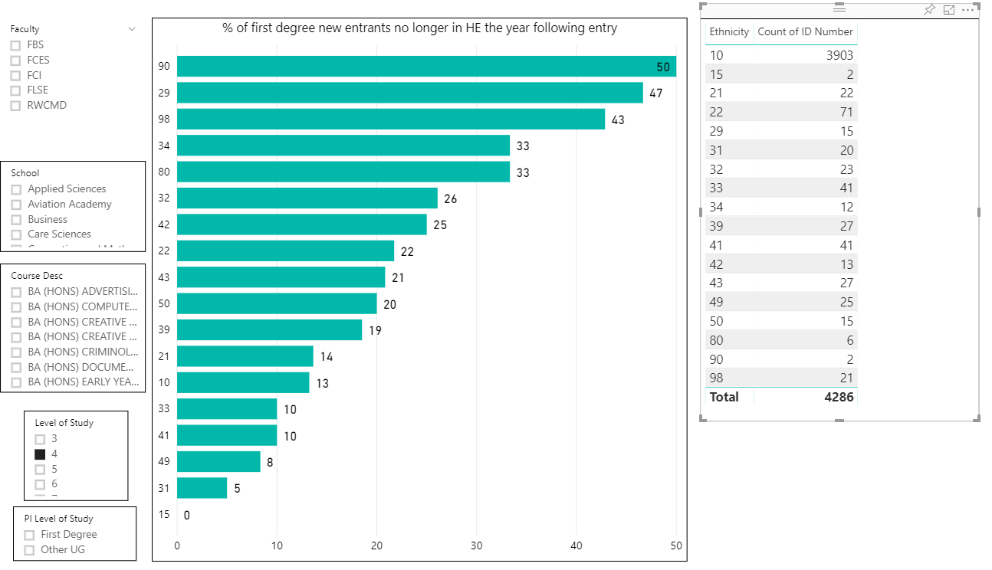
Influencing – Equality and Diversity Conversations
10 = White
90 = Unknown
29 = Other Black
98 = Refused
49 = Other mixed
31 = Asian or Asian British (Indian)

Slide 33
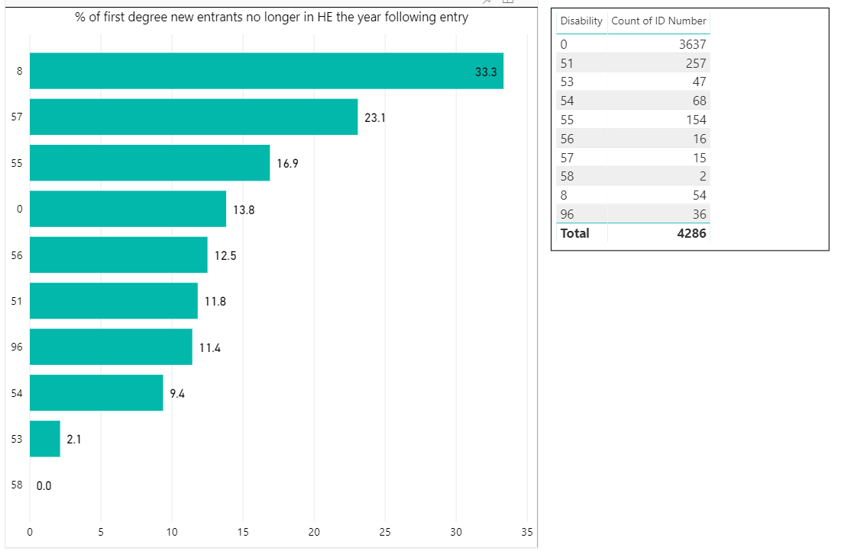
Influencing – Equality and Diversity Conversations
8 = two or more impairments
57 = Deaf or hearing
55 = Mental health condition
0 = no known disability
53 = Social/communication

Slide 34
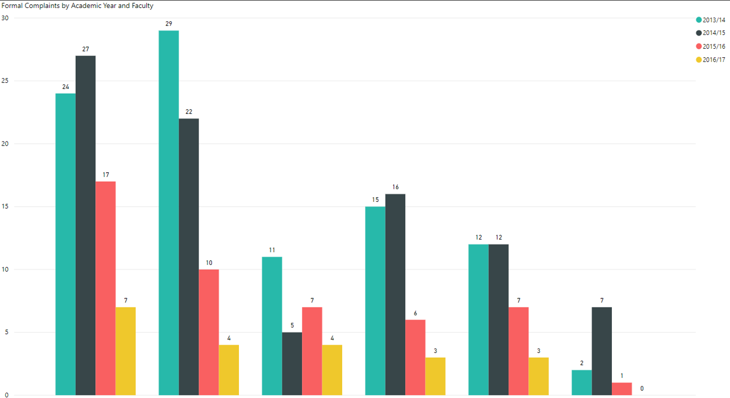
Driving Data Quality and Collection
Providing areas with ideas on how to monitor their data and present it usefully to the wider University – example is numbers of complaints

Slide 35
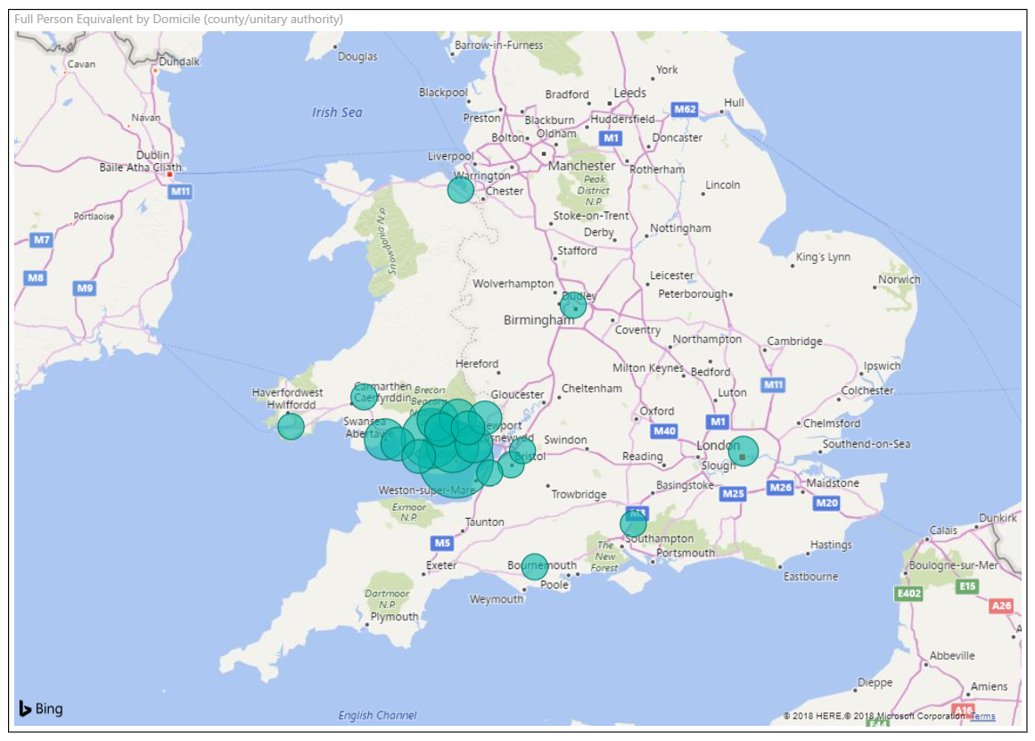
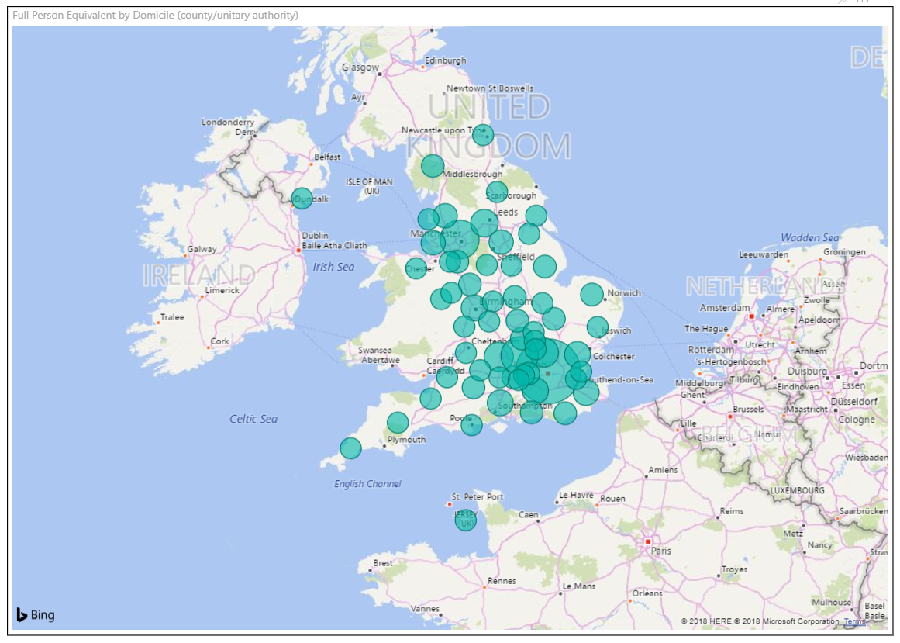
Incidental Benefit
Providing Schools and Faculties with sector wide information on competitors

Slide 36
But…none of this is about data

Slide 37
It’s a psychology to change culture
Experiment
Quick wins
Increased awareness and competition
Impact
Many see the results
Further increases in engagement
Engagement
Awareness
Leader
Few Champions
Underground
Minority involvement
Increased visibility
Know the business
Evidence Change
Continuous Improvement

Slide 38
Personally...
Engage with your University’s information channels… most HEIs are doing something similar to USW
Consider how the data and information already available can be used to augment QAE
Are there processes, reporting etc. within your area that could be enhanced by use of Business Intelligence?
How does data and information influence your priorities?

Slide 39
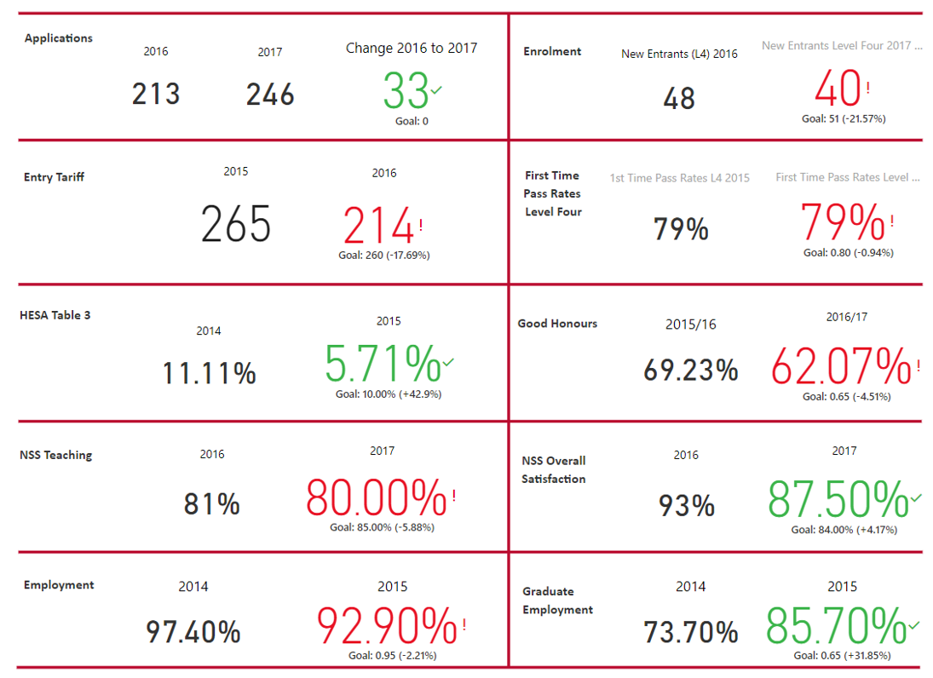
Example…Course Health (Data purely adds depth and brings things to life)

Slide 40
Questions?
Discussion…..

