Slide 1
Whatever happened to Learning and Teaching?
David Kernohan – Associate Editor
@dkernohan
Wonkhe.com

Slide 2
1. Introductions

Slide 3
Introducing Wonkhe (pron. “wonky”)
The home of higher education policy, people and politics
Wonk: a studious or hard-working person ... who takes an excessive interest in the details of policy.
We do TWO main things;
Publish articles (that we write, edit or commission)
Send email briefings, to help explain what’s going on
We also have a podcast, run events, training, consultancy, present etc.
Notes:
http://wonkhe.com/about-us/

Slide 4
Notes:
http://wonkhe.com/write-for-wonkhe/

Slide 5
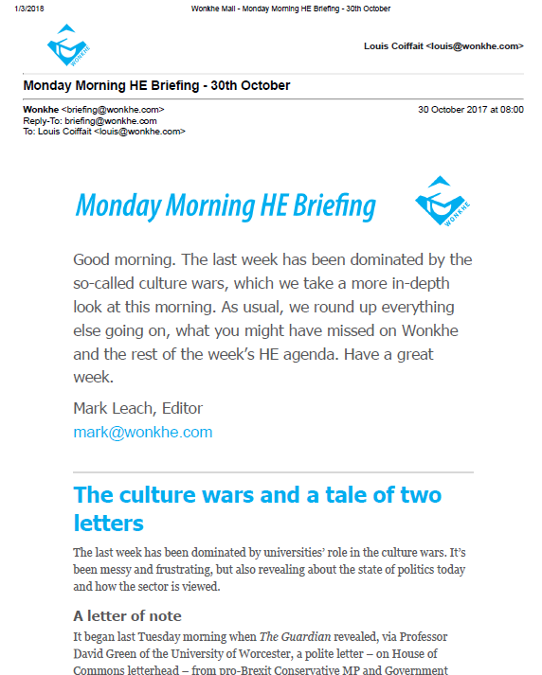
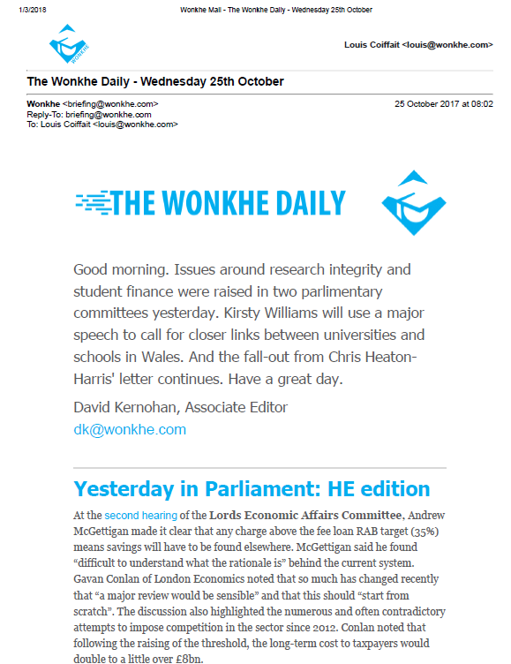
Email briefings; Monday, Daily (Tue-Thur)
FREE
SUBSCRIPTION
Notes:
http://wonkhe.com/monday-morning-he-briefing/ (free)
http://wonkhe.com/wonkhe-daily/ (£3.2k+VAT per org.)

Slide 6
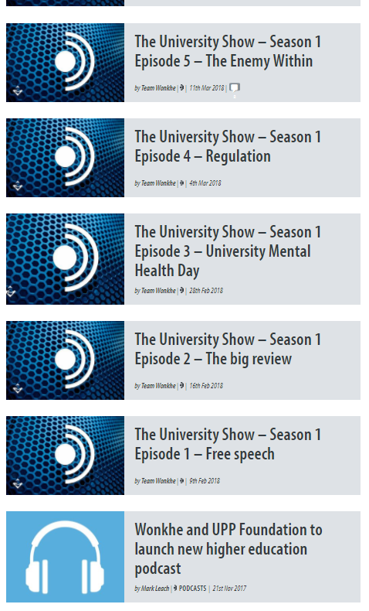
Events, podcasts etc…
Notes:
https://wonkhe.com/events/
https://wonkhe.com/blogs/live-its-alive-a-one-day-conference/
https://wonkhe.com/blog-themes/podcasts/

Slide 7
Current national teaching focus…
TEF (and Subject TEF)
Learning gain
Learner Analytics
Measurement, not enhancement
Stick, not carrot
Outputs, not outcomes

Slide 8
TEF (and Subject TEF)
Subject TEF
Trial 1
Subject TEF
Trial 2
Top down or bottom up?
Test of chosen model
STATUTORY REVIEW
TEF Year 1
TEF Year 2
TEF Year 3
(TEaSOF)
TEF Year 4?
LESSONS LEARNED
Eligibility only
QAA validation
HESA/NSS data
Access statement
Fundable body or course
Metrics
NSS - teaching
NSS – A&F
NSS – Ac support
Non-Continuation
DLHE Empl/FS
DLHE HS Emply
Splits
Tweaks
Half-weighting NSS
Grade inflation
LEO
?

Slide 9
TEF3

Slide 10
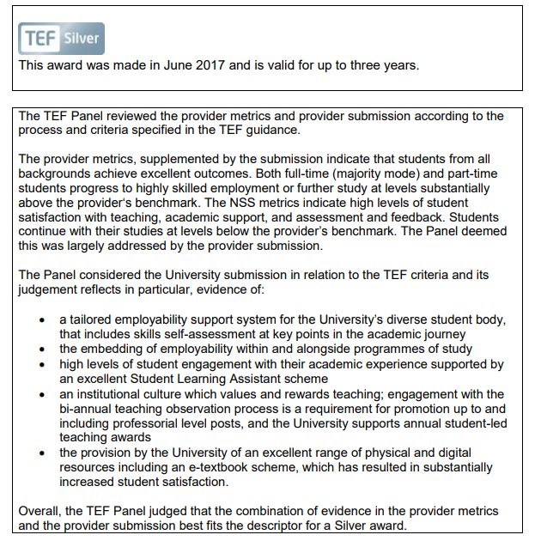
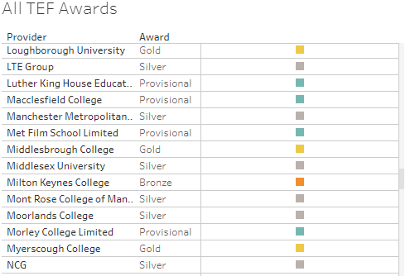
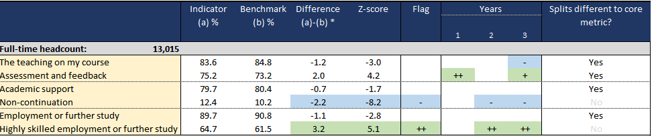

Slide 11
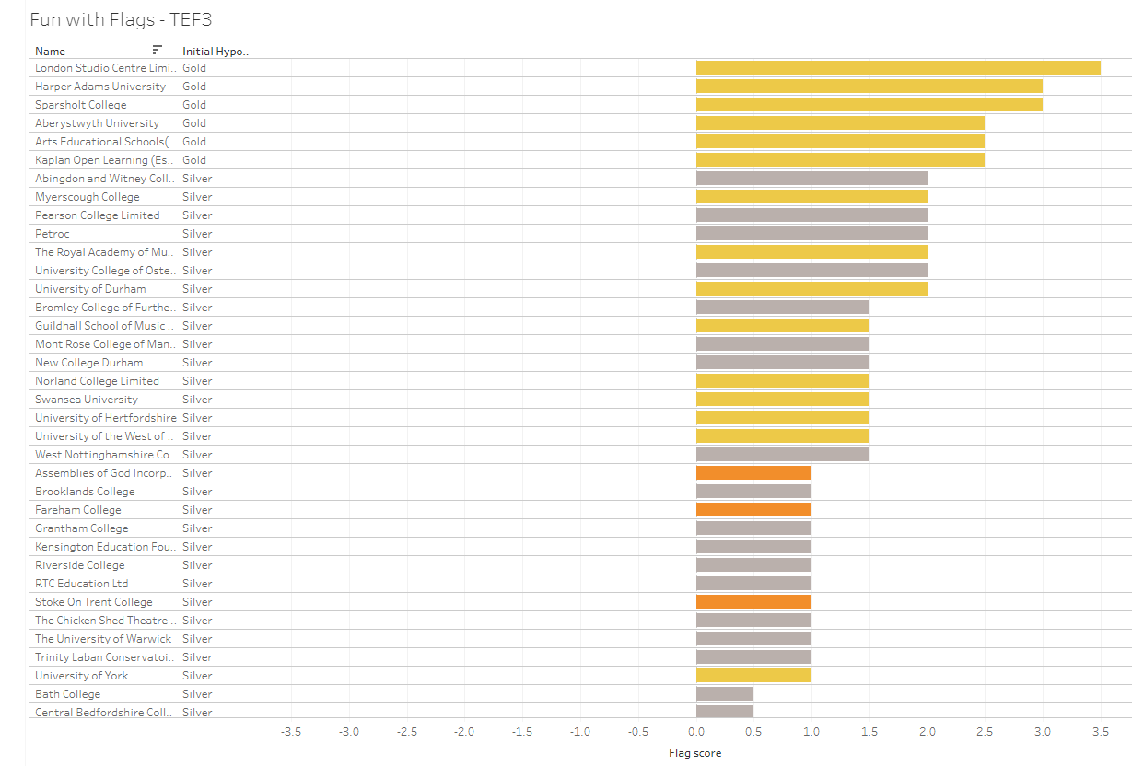

Slide 12
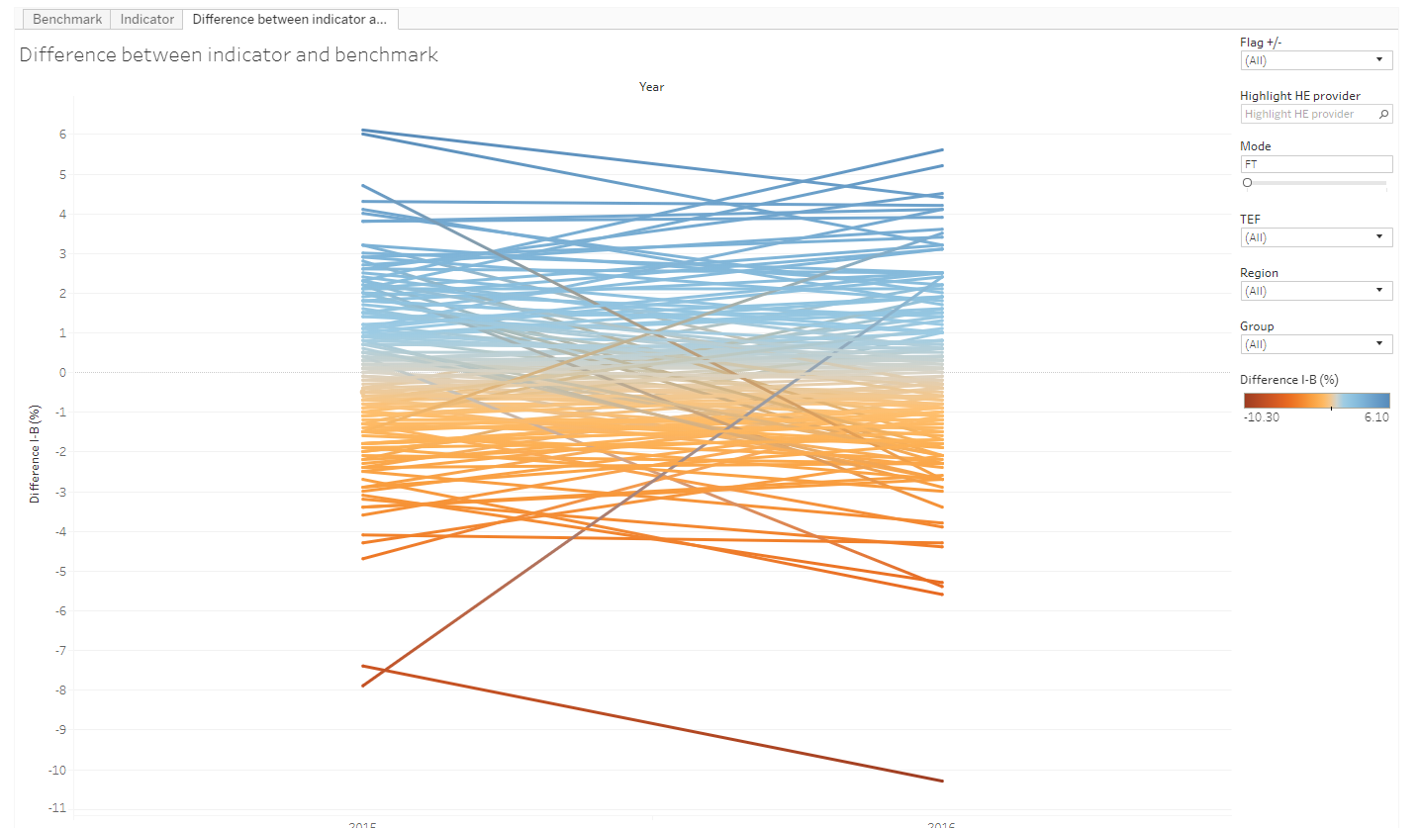
DLHE?

Slide 13
DLHE weighting?
Other supplementary metrics?
We gained LEO and grade inflation – what about the other “moral panics”?
Learning from subject TEF pilot?
Statutory review?

Slide 14
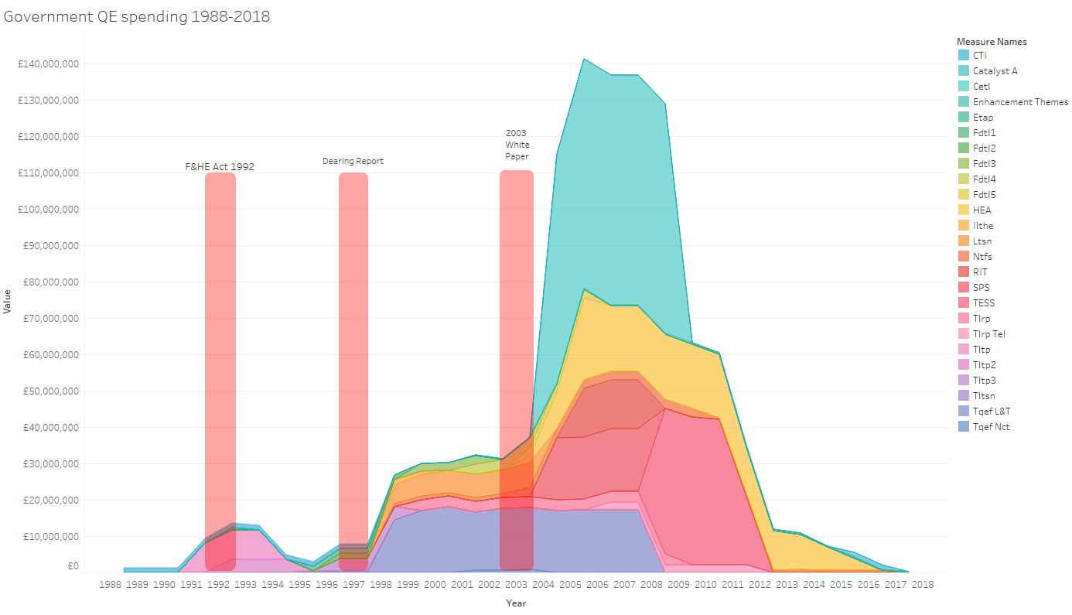
https://wonkhe.com/blogs/after-the-goldrush-30-years-of-teaching-quality-enhancement/

Slide 15
Current trends in teaching quality can be linked to a wider cultural need to define a “proof of value for HE”

Slide 16
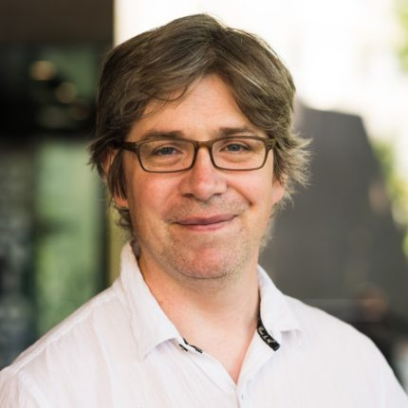
Thank you
David Kernohan – Associate Editor
@dkernohan, @wonkhe
wonkhe.com

